Slide 1
Bagging & Random Forests
Y.LAKSHMI PRASAD
08978784848

Slide 2
Bagging (Bootstrap Aggregation)
Bagging stands for Bootstrap Aggregation.
Bootstrapping means creating bootstrap samples from a given data set.
A bootstrap sample is created by sampling the given data set uniformly and with replacement.
A bootstrap sample typically contains about 30-70% data from the data set.
Aggregation implies combining the results of different models present in the ensemble.

Slide 3
Bagging (Bootstrap Aggregation)
1. Generate a number of training data sets using bootstrap sampling from the original data.
2.Training sets are used to generate a set of models using single learning algorithm
3. Model predictions are combined using voting for classification, averaging for regression
4. Sampling with replacement result in duplicates within a data set. For large sample size, sample data is expected to have roughly 63.2% unique data points and the rest being duplicates

Slide 4
Bagging (Bootstrap Aggregation)
5.Consequently, every bootstrap sample will be missing some of the instances from the original data set and as a result each bootstrap sample lead to a different model
6.Decision trees are specifically suited for bagging ensemble. A small change in the data will generate completely different trees (diff features may be selected for the split in different order)

Slide 5
Training data Sampling
INPUT
Space PARTITION
Output Space COMBINER

Slide 6
BAGGING (Bootstrap Aggregation)
TRAINING PHASE

Slide 7
BAGGING (Bootstrap Aggregation)
SCORING PHASE

Slide 8
Feature Sampling in Random Forest
INPUT
Space PARTITION
Output Space COMBINER

Slide 9
Random Forest
Random Forests introduce two levels of randomness in the tree building process which help in handling the noise in the data.
1. Random Forest takes a random subset of all the observations present in training dataset
2. It also takes a random subset of all the variables from the training dataset

Slide 10
Random Forest
1.Random Forest is used for ensemble of decision trees. It uses base principle of bagging with random feature selection to create more diverse trees
2. Splitting a node during the construction of a tree, the split that is chosen is no longer the best split among all the features. Instead, the split picked is the best split among a random subset of the features
3. As a result of this randomness, the bias of the forest usually slightly increases (with respect to the bias of a single non-random tree)

Slide 11
Random Forest
4. Due to averaging, its variance decreases, usually more than compensating the increase in bias, hence yielding overall a better result.
5. Can handle curse of dimensionality as the ensemble uses only a small random portion of the full feature set. Less prone to over-fitting.
6. Select Sqrt(P) where P = number of features

Slide 12
Random Forest
TRAINING PHASE

Slide 13
Random Forest
Input

Slide 14
Why ensemble is better?
Consider a binary classification problem where the response variable is either 0 or 1.
You have an ensemble of three models, where each model has an accuracy of 0.7 i.e. it is correct 70% of the times.
The following table shows all the possible cases that can occur while classifying a test data point as 1 or 0.
The column to the extreme right shows the probability of each case.

Slide 15
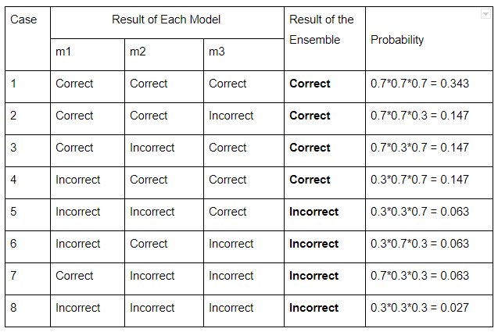
Why ensemble is better?

Slide 16
Why ensemble is better?
In the table, there are 4 cases each where the decision of the final model (ensemble) is either correct or wrong.
Let’s assume that the probability of the ensemble being correct is p, and the probability of the ensemble being wrong is q.
For the data in the table, p and q can be calculated as follows:
p = 0.343 + 0.147 + 0.147 + 0.147 = 0.784
q = 0.027 + 0.063 + 0.063 + 0.063 = 0.216 = 1 – p
You can see how an ensemble of just three model gives a boost to the accuracy from 70% to 78.4%.
In general, the more the number of models, the higher the accuracy of an ensemble is.

Slide 17
Advantages of a Random Forest
There are several advantages of a random forest:
1. A random forest is more stable than any single decision tree because the results get averaged out; it is not affected by the instability and bias of an individual tree.
2. A random forest is immune to the curse of dimensionality since only a subset of features is used to split a node.
3. You can parallelize the training of a forest since each tree is constructed independently.

Slide 18
Advantages of a Random Forest
4. You can calculate the OOB (Out-of-Bag) error using the training set which gives a really good estimate of the performance of the forest on unseen data.
Hence there is no need to split the data into training and validation; you can use all the data to train the forest.

Slide 19
OOB (Out-of-Bag) Error
The OOB error is calculated by using each observation of the training set as a test observation. Since each tree is built on a bootstrap sample, each observation can used as a test observation by those trees which did not have it in their bootstrap sample.
All these trees predict on this observation and you get an error for a single observation.
The final OOB error is calculated by calculating the error on each observation and aggregating it.
It turns out that the OOB error is as good as cross validation error.

Slide 20
Time taken to build a forest
To construct a forest of ‘S’ trees, on a dataset which has ‘M’ features and ‘N’ observations, the time taken will depends on the following factors:
1. The number of trees. The time is directly proportional to the number of trees. But this time can be reduced by creating the trees in parallel.

Slide 21
Time taken to build a forest
2. The size of bootstrap sample. Generally the size of a bootstrap sample is 30-70% of N.
The smaller the size the faster it takes to create a forest.
3. The size of subset of features while splitting a node.
Generally this is taken as √𝑀 in classification and M/3 in regression.

Slide 22
HyperParameters in Random Forest
1. n_estimators : integer, optional (default=10)The number of trees in the forest.
2. criterion : string, optional (default=”gini”)The function to measure the quality of a split.
Supported criteria are “gini” for the Gini impurity and “entropy” for the information gain.
3. max_depth : integer or None, optional (default=None)The maximum depth of the tree. If None, then nodes are expanded until all leaves are pure or until all leaves contain less than min_samples_split samples.

Slide 23
HyperParameters in Random Forest
4. max_features : int, float, string or None, optional (default=”auto”)The number of features to consider when looking for the best split:
5. bootstrap : boolean, optional (default=True)
Whether bootstrap samples are used when building trees. If False, the whole dataset is used to build each tree.
6. oob_score : bool (default=False) Whether to use out-of-bag samples to estimate the generalization accuracy.

Slide 24
HyperParameters in Random Forest
7. warm_start : bool, optional (default=False)When set to True, reuse the solution of the previous call to fit and add more estimators to the ensemble, otherwise, just fit a whole new forest.
8. n_jobs : int or None, optional (default=None) The number of jobs to run in parallel for both fit and predict. None means 1 and -1 means using all processors.

Slide 25
Any Questions?
THANK YOU

